Slide 1


Slide 2
Angular Component Interactions
Angular
55
Parent to Child
Child to Parent
Siblings transfer
Viewchild

Slide 3
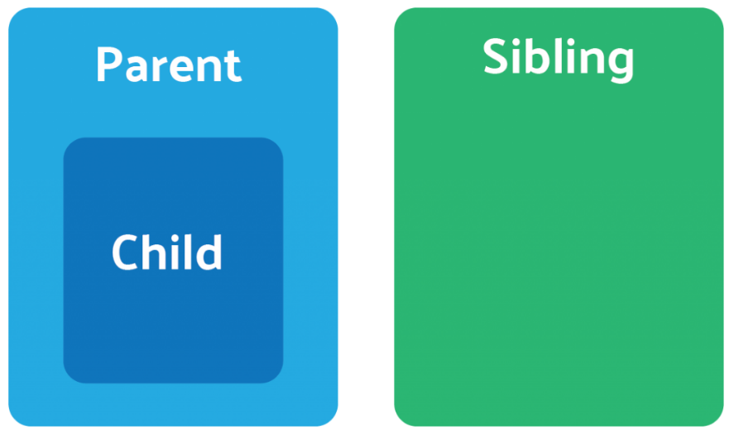
Angular Component Interaction -1
Angular
55

Slide 4
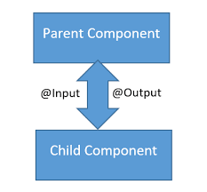
Angular Component Interaction -2
Angular
55

Slide 5
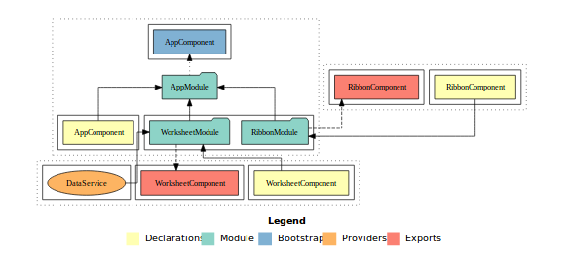
Angular Component Interaction -3
Angular
55

Slide 6
That’s All For Today Day-5 !!
Questions?

Slide 7
Thank You
shiva1991@live.com

